Slide 1

딥러닝 학습 – 오차역전파(Error Backpropagation)
2022-01-11

Slide 2
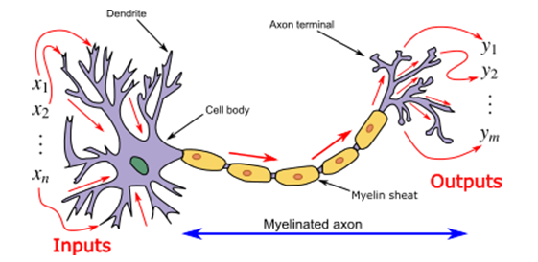
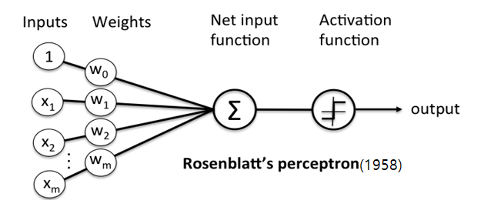
퍼셉트론(Perceptron)
인공신경망의 한 종류
인간의 뉴런을 본따서 만듦
여러 입력신호의 총 합이 임계치를 넘어설 경우 1을 넘어서지 않을 경우 0을 반환
선형회귀 및 로지스틱함수 유사한 구조

Slide 3
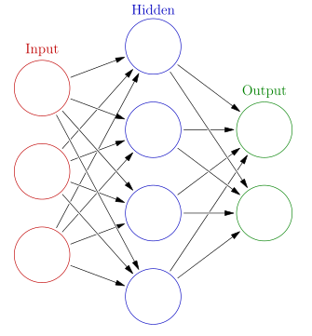
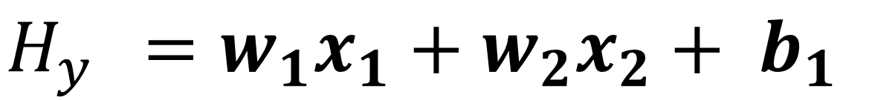
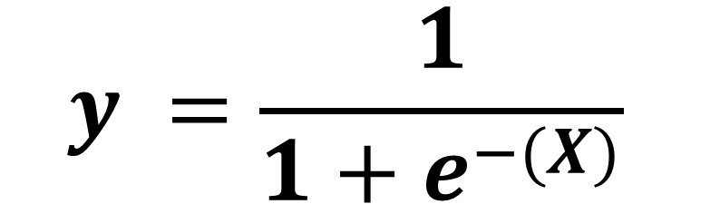
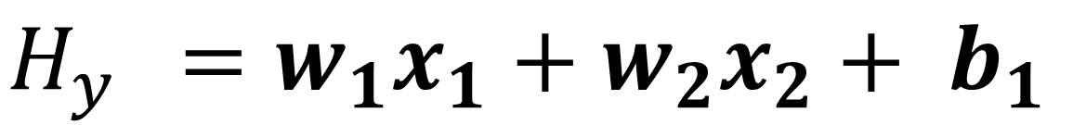
뉴럴 네트워크(Neural Network)
다층 퍼셉트론(Multi-Layer Perceptron, MLP)
뉴럴 네트워크(Neural Network)
$H_{y }$ $=w_{1}x_{1}+w_{2}x_{2}+ b_{1}$
$H_{y }$ $=w_{1}x_{1}+w_{2}x_{2}+ b_{1}$
1 if y > threshold
0 if y < threshold
$$y =\frac{1}{1+e^{−(X)}}$$

Slide 4
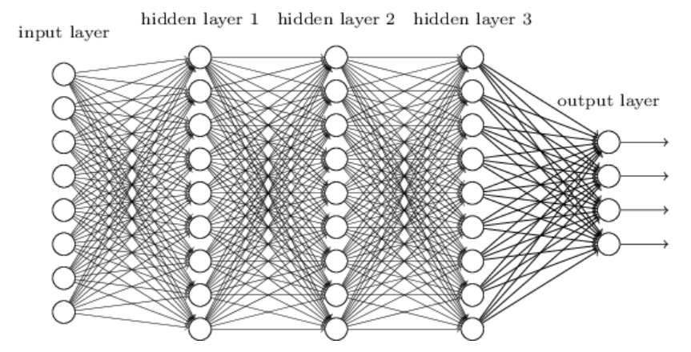
심층 신경망(Deep Neural Network)
심층 신경망(Deep Neural Network, DNN)
뉴런 수만 무한하다면 은닉층 하나로 어떠한 한수도 근사할 수 있음
그러나 심층 신경망이 얕은 신경망보다 파라미터 효율성이 훨씬 좋으며 복잡한 함수를 모델링 하는데에 있어 얕은 신경망보다 훨씬 적은 수의 뉴런을 사용하기 때문에 학습시간이 빠름

Slide 5
딥러닝 알고리즘 - 회귀문제
아무 가중치나 설정한다.
해당 가중치의 가설함수 값을 구한다.
비용함수를 통해 Cost를 구한다.
비용함수의 기울기를 구한다.
기울기와 학습율을 곱하여 가중치를 수정한다.
(2~5번 여러 번 반복)
피드포워드(Feed Forward)
오차역전파(Backpropagation)

Slide 6
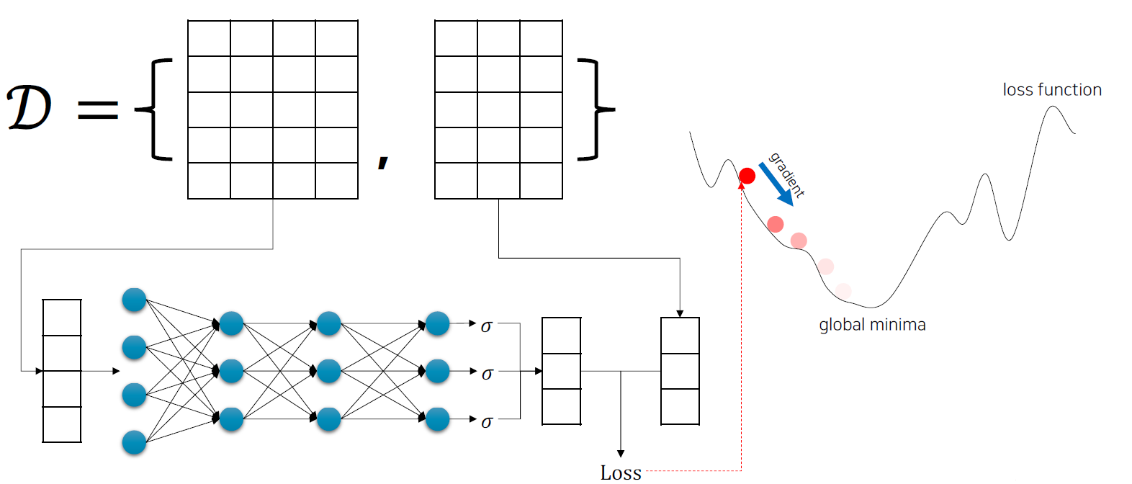
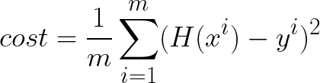













딥러닝 알고리즘 - 회귀문제
$$x_{0}$$
$$x_{1}$$
$$x_{2}$$
$$x_{3}$$
$$y_{0}$$
$$y_{1}$$
$$y_{2}$$
피드포워드(Feed Forward)
$$\dot{\hat{y_{0}}}$$
$$y_{0}$$
$$\dot{\hat{y_{1}}}$$
$$y_{1}$$
$$\dot{\hat{y_{2}}}$$
$$y_{2}$$
오차역전파(Backpropagation)

Slide 7





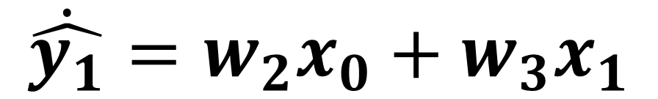

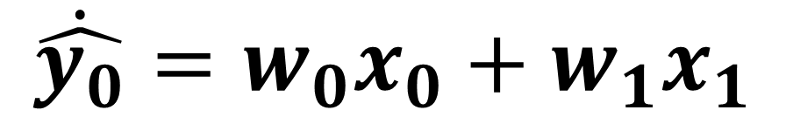


다중 선형회귀 – Feed Forward & Backpropagation
절편(Bias)는 생략
$$\dot{\hat{y_{0}}}=w_{0}x_{0}+w_{1}x_{1}$$
$$\dot{\hat{y_{1}}}=w_{2}x_{0}+w_{3}x_{1}$$
$$w_{0}$$
$$x_{0}$$
$$y_{0}$$
$$w_{1}$$
$$w_{2}$$
$$w_{3}$$
$$x_{1}$$
$$y_{1}$$

Slide 8
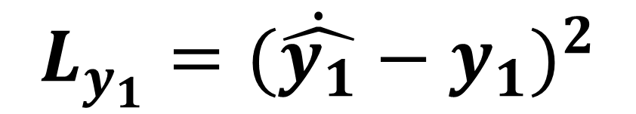
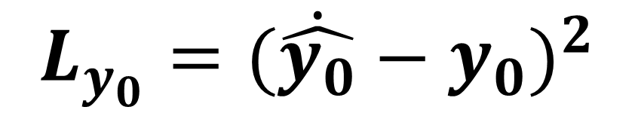
다중 선형회귀 – Feed Forward & Backpropagation
절편(Bias)는 생략
$$\dot{\hat{y_{0}}}=w_{0}x_{0}+w_{1}x_{1}$$
$$\dot{\hat{y_{1}}}=w_{2}x_{0}+w_{3}x_{1}$$
$$w_{0}$$
$$x_{0}$$
$$y_{0}$$
$$w_{1}$$
$$L_{y_{0}}={(\dot{\hat{y_{0}}}−y_{0})}^{2}$$
$$L_{y_{1}}={(\dot{\hat{y_{1}}}−y_{1})}^{2}$$
$$w_{2}$$
$$L_{Total}={(\dot{\hat{y_{0}}}−y_{0})}^{2}+{(\dot{\hat{y_{1}}}−y_{1})}^{2}$$
$$w_{3}$$
$$x_{1}$$
$$y_{1}$$

Slide 9




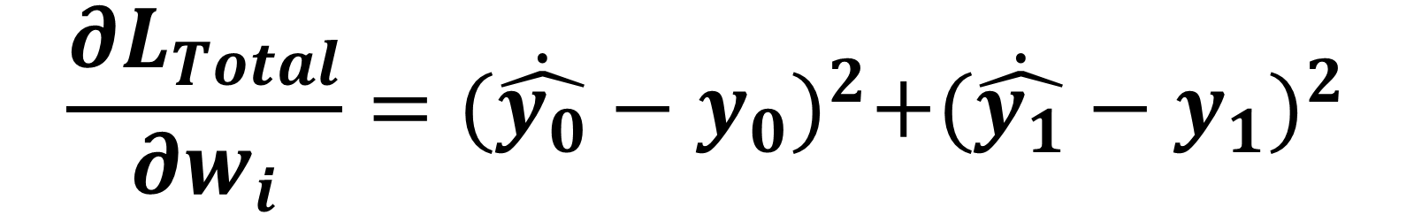
다중 선형회귀 – Feed Forward & Backpropagation
절편(Bias)는 생략
$$\dot{\hat{y_{0}}}=w_{0}x_{0}+w_{1}x_{1}$$
$$\dot{\hat{y_{1}}}=w_{2}x_{0}+w_{3}x_{1}$$
$$w_{0}$$
$$x_{0}$$
$$y_{0}$$
$$w_{1}$$
$$L_{y_{0}}={(\dot{\hat{y_{0}}}−y_{0})}^{2}$$
$$L_{y_{1}}={(\dot{\hat{y_{1}}}−y_{1})}^{2}$$
$$w_{2}$$
$$L_{Total}={(\dot{\hat{y_{0}}}−y_{0})}^{2}+{(\dot{\hat{y_{1}}}−y_{1})}^{2}$$
$$w_{3}$$
$$\frac{{∂L}_{Total}}{{∂w}_{i}}={(\dot{\hat{y_{0}}}−y_{0})}^{2}+{(\dot{\hat{y_{1}}}−y_{1})}^{2}$$
$$x_{1}$$
$$y_{1}$$
$$\frac{{∂L}_{Total}}{{∂w}_{0}}$$
$$\frac{{∂L}_{Total}}{{∂w}_{1}}$$
$$\frac{{∂L}_{Total}}{{∂w}_{2}}$$
$$\frac{{∂L}_{Total}}{{∂w}_{3}}$$

Slide 10
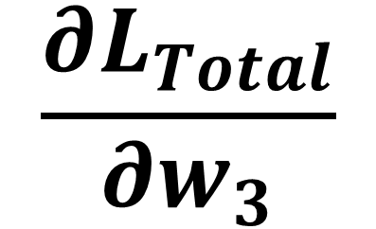
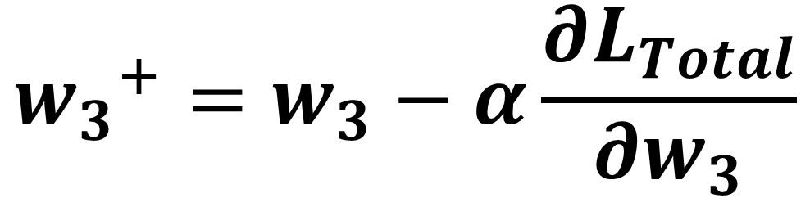
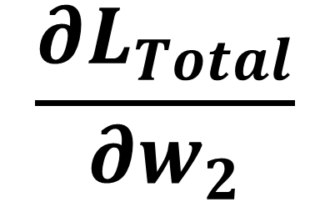
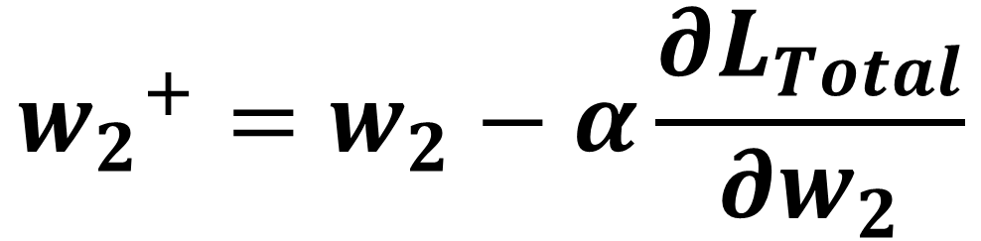
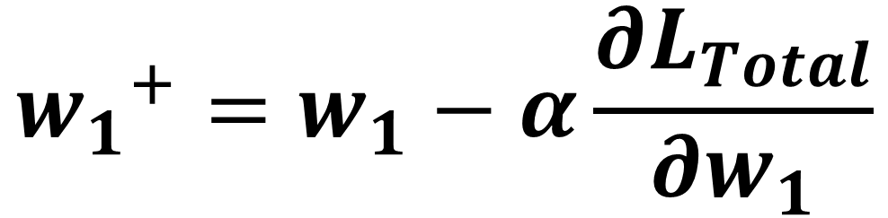
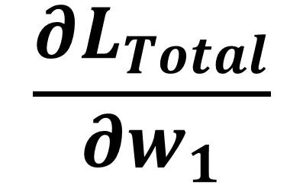
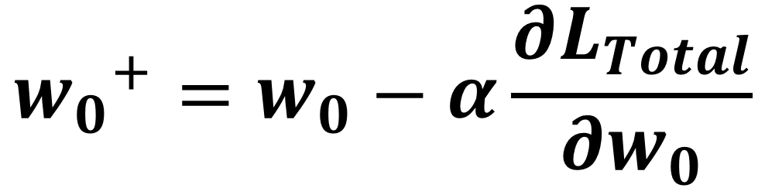
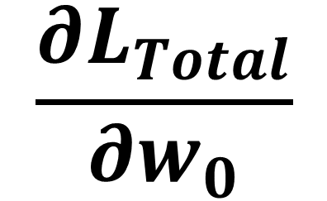
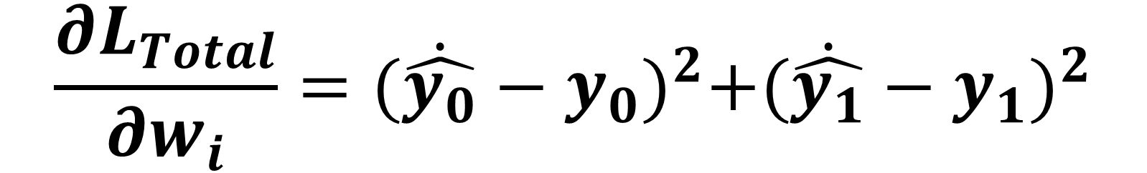
다중 선형회귀 – Feed Forward & Backpropagation
절편(Bias)는 생략
$$\frac{{∂L}_{Total}}{{∂w}_{i}}={(\dot{\hat{y_{0}}}−y_{0})}^{2}+{(\dot{\hat{y_{1}}}−y_{1})}^{2}$$
$$w_{0}$$
$$\frac{{∂L}_{Total}}{{∂w}_{0}}$$
$$\frac{{∂L}_{Total}}{{∂w}_{1}}$$
$$\frac{{∂L}_{Total}}{{∂w}_{2}}$$
$$\frac{{∂L}_{Total}}{{∂w}_{3}}$$
$$x_{0}$$
$$y_{0}$$
$$w_{1}$$
$${w_{0}}^{+}=w_{0}−α\frac{{∂L}_{Total}}{{∂w}_{0}}$$
$$w_{2}$$
$${w_{1}}^{+}=w_{1}−α\frac{{∂L}_{Total}}{{∂w}_{1}}$$
$$w_{3}$$
$$x_{1}$$
$$y_{1}$$
$${w_{2}}^{+}=w_{2}−α\frac{{∂L}_{Total}}{{∂w}_{2}}$$
$${w_{3}}^{+}=w_{3}−α\frac{{∂L}_{Total}}{{∂w}_{3}}$$

Slide 11
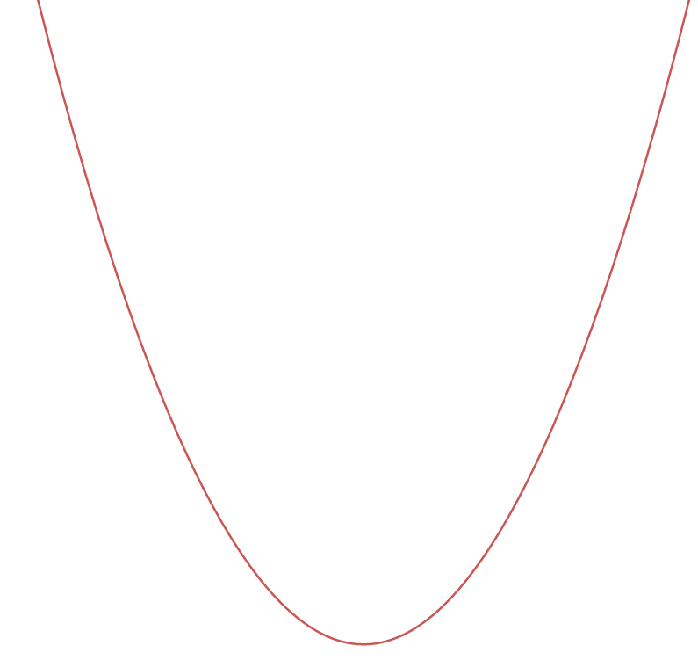


다중 선형회귀 – Feed Forward & Backpropagation
Multiple Linear Regression
1. 다중 선형회귀 함수
COST(비용)
$$\dot{\hat{y_{i}}}=w_{0}x_{0}+…+w_{i}x_{i}+b$$
2. 다중 선형회귀 비용 함수
$$Cost=\frac{1}{m}\sum_{i=1}^{m}{\frac{1}{2}{(\dot{\hat{y_{i}}}−y)}^{2}}$$
3. 다중 선형회귀 목적 함수
$$\frac{d}{dw_{i}}Cost=\frac{1}{m}\sum_{i=1}^{m}{(H\left(w_{i}\right)−y)x^{i}}$$
가중치(W)

Slide 12
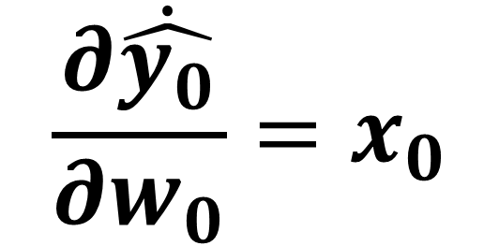
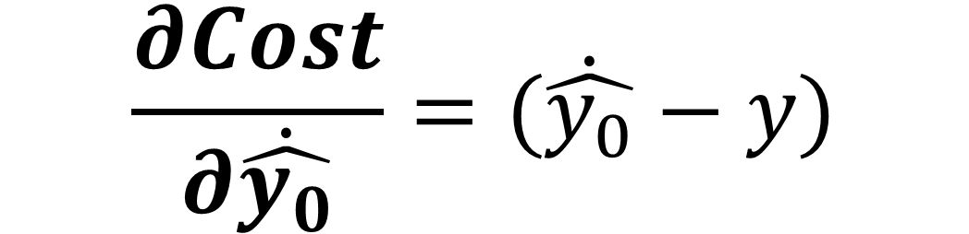
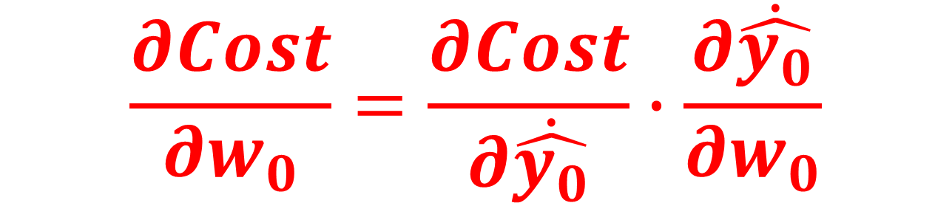
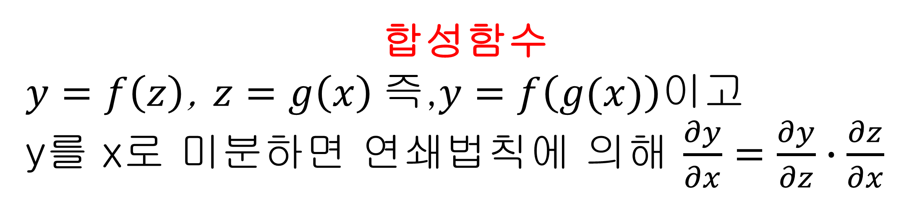
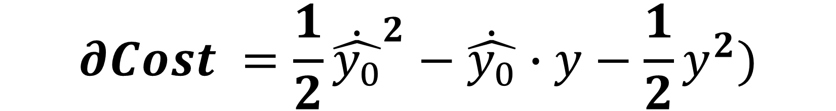
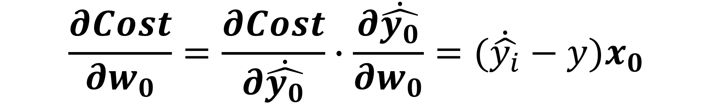
다중 선형회귀 – Feed Forward & Backpropagation
Multiple Linear Regression
합성함수
$y=f\left(z\right)$, $z=g\left(x\right)$즉,$y=f\left(g(x)\right)$이고
y를 x로 미분하면 연쇄법칙에 의해 $\frac{∂y}{∂x}=\frac{∂y}{∂z}∙\frac{∂z}{∂x}$
1. 다중 선형회귀 함수
$$\dot{\hat{y_{i}}}=w_{0}x_{0}+…+w_{i}x_{i}+b$$
2. 다중 선형회귀 비용 함수
$$\frac{∂Cost}{{∂w}_{0}}=\frac{∂Cost}{∂\dot{\hat{y_{0}}}}∙\frac{∂\dot{\hat{y_{0}}}}{{∂w}_{0}}$$
$$Cost=\frac{1}{m}\sum_{i=1}^{m}{\frac{1}{2}{(\dot{\hat{y_{i}}}−y)}^{2}}$$
$$∂Cost =\frac{1}{2}{\dot{\hat{y_{0}}}}^{2}−\dot{\hat{y_{0}}}∙y−\frac{1}{2}y^{2})$$
3. 다중 선형회귀 목적 함수
$$\frac{d}{dw_{i}}Cost=\frac{1}{m}\sum_{i=1}^{m}{(H\left(w_{i}\right)−y)x^{i}}$$
$$\frac{∂Cost}{∂\dot{\hat{y_{0}}}}=(\dot{\hat{y_{0}}}−y)$$
$$\frac{∂\dot{\hat{y_{0}}}}{{∂w}_{0}}=x_{0}$$
$$\frac{∂Cost}{{∂w}_{0}}=\frac{∂Cost}{∂\dot{\hat{y_{0}}}}∙\frac{∂\dot{\hat{y_{0}}}}{{∂w}_{0}}=(\dot{\hat{y_{i}}}−y)x_{0}$$

Slide 13
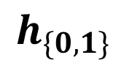




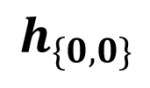








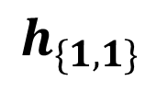


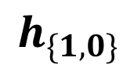


딥러닝 (Feed Forward & Backpropagation)
절편(Bias)는 생략
$$w_{0}$$
$$h_{\{0,0\}}$$
$$w_{4}$$
$$w_{8}$$
$$\dot{\hat{y_{0}}}$$
$$x_{0}$$
$$h_{\{1,0\}}$$
$$w_{2}$$
$$w_{6}$$
$$w_{10}$$
$$w_{1}$$
$$w_{5}$$
$$w_{9}$$
$$x_{1}$$
$$h_{\{0,1\}}$$
$$h_{\{1,1\}}$$
$$\dot{\hat{y_{1}}}$$
$$w_{3}$$
$$w_{7}$$
$$w_{11}$$

Slide 14
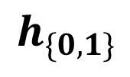
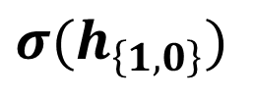




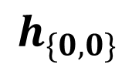
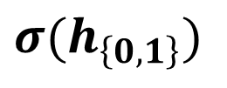





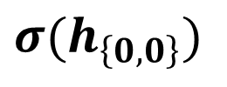




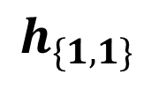


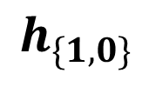
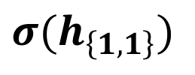

딥러닝 (Feed Forward & Backpropagation)
절편(Bias)는 생략
$$w_{0}$$
$$h_{\{0,0\}}$$
$$σ(h_{\left\{0,0\right\}})$$
$$w_{4}$$
$$w_{8}$$
$$\dot{\hat{y_{0}}}$$
$$x_{0}$$
$$h_{\{1,0\}}$$
$$σ(h_{\left\{1,0\right\}})$$
$$w_{2}$$
$$w_{6}$$
$$w_{10}$$
$$w_{1}$$
$$w_{5}$$
$$w_{9}$$
$$x_{1}$$
$$h_{\{0,1\}}$$
$$σ(h_{\left\{0,1\right\}})$$
$$h_{\{1,1\}}$$
$$σ(h_{\left\{1,1\right\}})$$
$$\dot{\hat{y_{1}}}$$
$$w_{3}$$
$$w_{7}$$
$$w_{11}$$

Slide 15
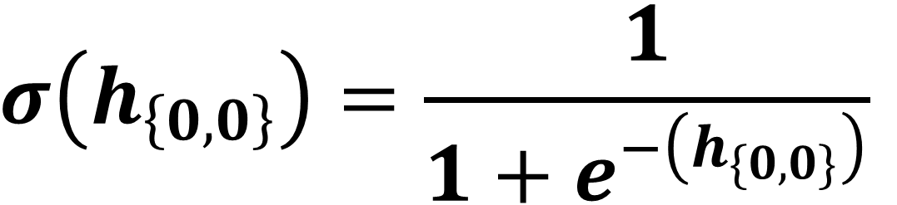
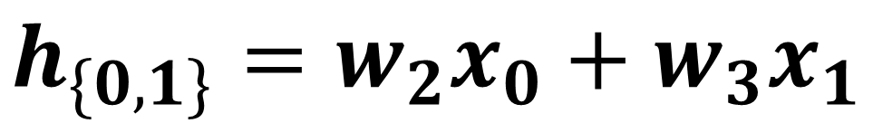
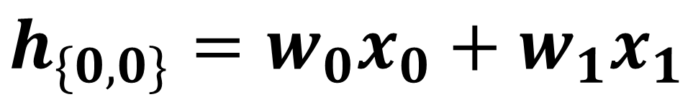

딥러닝 (Feed Forward & Backpropagation)
$$w_{0}$$
$$h_{\{0,0\}}$$
$$σ(h_{\left\{0,0\right\}})$$
$$w_{4}$$
$$w_{8}$$
$$\dot{\hat{y_{0}}}$$
$$x_{0}$$
$$h_{\{1,0\}}$$
$$σ(h_{\left\{1,0\right\}})$$
$$w_{2}$$
$$w_{6}$$
$$w_{10}$$
$$w_{1}$$
$$w_{5}$$
$$w_{9}$$
$$x_{1}$$
$$h_{\{0,1\}}$$
$$σ(h_{\left\{0,1\right\}})$$
$$h_{\{1,1\}}$$
$$σ(h_{\left\{1,1\right\}})$$
$$\dot{\hat{y_{1}}}$$
$$w_{3}$$
$$w_{7}$$
$$w_{11}$$
$$σ\left(h_{\left\{0,0\right\}}\right)=\frac{1}{1+e^{−\left(h_{\{0,0\}}\right)}}$$
$$h_{\{0,0\}}=w_{0}x_{0}+w_{1}x_{1}$$
$$σ\left(h_{\left\{0,1\right\}}\right)=\frac{1}{1+e^{−\left(h_{\{0,1\}}\right)}}$$
$$h_{\{0,1\}}=w_{2}x_{0}+w_{3}x_{1}$$

Slide 16


딥러닝 (Feed Forward & Backpropagation)
$$w_{0}$$
$$h_{\{0,0\}}$$
$$σ(h_{\left\{0,0\right\}})$$
$$w_{4}$$
$$w_{8}$$
$$\dot{\hat{y_{0}}}$$
$$x_{0}$$
$$h_{\{1,0\}}$$
$$σ(h_{\left\{1,0\right\}})$$
$$w_{2}$$
$$w_{6}$$
$$w_{10}$$
$$w_{1}$$
$$w_{5}$$
$$w_{9}$$
$$x_{1}$$
$$h_{\{0,1\}}$$
$$σ(h_{\left\{0,1\right\}})$$
$$h_{\{1,1\}}$$
$$σ(h_{\left\{1,1\right\}})$$
$$\dot{\hat{y_{1}}}$$
$$w_{3}$$
$$w_{7}$$
$$w_{11}$$
$$h_{\{1,0\}}=w_{4}σ\left(h_{\left\{0,0\right\}}\right)+w_{5}σ\left(h_{\left\{0,1\right\}}\right)$$
$$σ\left(h_{\left\{1,0\right\}}\right)=\frac{1}{1+e^{−\left(h_{\{1,0\}}\right)}}$$
$$σ\left(h_{\left\{1,1\right\}}\right)=\frac{1}{1+e^{−\left(h_{\{1,1\}}\right)}}$$
$$h_{\{1,1\}}=w_{6}σ\left(h_{\left\{0,0\right\}}\right)+w_{7}σ\left(h_{\left\{0,1\right\}}\right)$$

Slide 17
딥러닝 (Feed Forward & Backpropagation)
$$w_{0}$$
$$h_{\{0,0\}}$$
$$σ(h_{\left\{0,0\right\}})$$
$$w_{4}$$
$$w_{8}$$
$$\dot{\hat{y_{0}}}$$
$$x_{0}$$
$$h_{\{1,0\}}$$
$$σ(h_{\left\{1,0\right\}})$$
$$w_{2}$$
$$w_{6}$$
$$w_{10}$$
$$w_{1}$$
$$w_{5}$$
$$w_{9}$$
$$x_{1}$$
$$h_{\{0,1\}}$$
$$σ(h_{\left\{0,1\right\}})$$
$$h_{\{1,1\}}$$
$$σ(h_{\left\{1,1\right\}})$$
$$\dot{\hat{y_{1}}}$$
$$w_{3}$$
$$w_{7}$$
$$w_{11}$$
$$\dot{\hat{y_{0}}}=w_{8}σ\left(h_{\left\{1,0\right\}}\right)+w_{9}σ\left(h_{\left\{1,1\right\}}\right)$$
$$\dot{\hat{y_{1}}}=w_{10}σ\left(h_{\left\{1,0\right\}}\right)+w_{11}σ\left(h_{\left\{1,0\right\}}\right)$$

Slide 18







딥러닝 (Feed Forward & Backpropagation)
$$L_{y_{0}}$$
$$w_{0}$$
$$h_{\{0,0\}}$$
$$σ(h_{\left\{0,0\right\}})$$
$$w_{4}$$
$$w_{8}$$
$$\dot{\hat{y_{0}}}$$
$$y_{0}$$
$$x_{0}$$
$$h_{\{1,0\}}$$
$$σ(h_{\left\{1,0\right\}})$$
$$w_{2}$$
$$w_{6}$$
$$w_{10}$$
$$w_{1}$$
$$w_{5}$$
$$w_{9}$$
$$L_{y_{1}}$$
$$x_{1}$$
$$h_{\{0,1\}}$$
$$σ(h_{\left\{0,1\right\}})$$
$$h_{\{1,1\}}$$
$$σ(h_{\left\{1,1\right\}})$$
$$\dot{\hat{y_{1}}}$$
$$y_{1}$$
$$w_{3}$$
$$w_{7}$$
$$w_{11}$$
$$\dot{\hat{y_{0}}}=w_{8}σ\left(h_{\left\{1,0\right\}}\right)+w_{9}σ\left(h_{\left\{1,1\right\}}\right)$$
$$\dot{\hat{y_{1}}}=w_{10}σ\left(h_{\left\{1,0\right\}}\right)+w_{11}σ\left(h_{\left\{1,0\right\}}\right)$$
$$L_{y_{0}}=\frac{1}{2}{(\dot{\hat{y_{0}}}−y_{0})}^{2}$$
$$L_{y_{1}}=\frac{1}{2}{(\dot{\hat{y_{1}}}−y_{1})}^{2}$$

Slide 19


딥러닝 (Feed Forward & Backpropagation)
$$L_{y_{0}}$$
$$w_{0}$$
$$h_{\{0,0\}}$$
$$σ(h_{\left\{0,0\right\}})$$
$$w_{4}$$
$$w_{8}$$
$$\dot{\hat{y_{0}}}$$
$$y_{0}$$
$$x_{0}$$
$$h_{\{1,0\}}$$
$$σ(h_{\left\{1,0\right\}})$$
$$w_{2}$$
$$w_{6}$$
$$w_{10}$$
$$w_{1}$$
$$w_{5}$$
$$w_{9}$$
$$L_{y_{1}}$$
$$x_{1}$$
$$h_{\{0,1\}}$$
$$σ(h_{\left\{0,1\right\}})$$
$$h_{\{1,1\}}$$
$$σ(h_{\left\{1,1\right\}})$$
$$\dot{\hat{y_{1}}}$$
$$y_{1}$$
$$w_{3}$$
$$w_{7}$$
$$w_{11}$$
$$\dot{\hat{y_{0}}}=w_{8}σ\left(h_{\left\{1,0\right\}}\right)+w_{9}σ\left(h_{\left\{1,1\right\}}\right)$$
$$L_{Total}=L_{y_{0}}+L_{y_{1}}$$
$$\dot{\hat{y_{1}}}=w_{10}σ\left(h_{\left\{1,0\right\}}\right)+w_{11}σ\left(h_{\left\{1,0\right\}}\right)$$
$$L_{y_{0}}=\frac{1}{2}{(\dot{\hat{y_{0}}}−y_{0})}^{2}$$
$$L_{y_{1}}=\frac{1}{2}{(\dot{\hat{y_{1}}}−y_{1})}^{2}$$
$$L_{Total}=\frac{1}{2}\{{\left(\dot{\hat{y_{0}}}−y_{0}\right)}^{2}+{\left(\dot{\hat{y_{1}}}−y_{1}\right)}^{2}\}$$

Slide 20














딥러닝 (Feed Forward & Backpropagation)
$$L_{y_{0}}$$
$$w_{0}$$
$$h_{\{0,0\}}$$
$$σ(h_{\left\{0,0\right\}})$$
$$w_{4}$$
$$w_{8}$$
$$\dot{\hat{y_{0}}}$$
$$y_{0}$$
$$x_{0}$$
$$h_{\{1,0\}}$$
$$σ(h_{\left\{1,0\right\}})$$
$$w_{2}$$
$$w_{6}$$
$$w_{10}$$
$$w_{1}$$
$$w_{5}$$
$$w_{9}$$
$$L_{y_{1}}$$
$$x_{1}$$
$$h_{\{0,1\}}$$
$$σ(h_{\left\{0,1\right\}})$$
$$h_{\{1,1\}}$$
$$σ(h_{\left\{1,1\right\}})$$
$$\dot{\hat{y_{1}}}$$
$$y_{1}$$
$$w_{3}$$
$$w_{7}$$
$$w_{11}$$
$$\dot{\hat{y_{0}}}=w_{8}σ\left(h_{\left\{1,0\right\}}\right)+w_{9}σ\left(h_{\left\{1,1\right\}}\right)$$
$$L_{Total}=L_{y_{0}}+L_{y_{1}}$$
$$\dot{\hat{y_{1}}}=w_{10}σ\left(h_{\left\{1,0\right\}}\right)+w_{11}σ\left(h_{\left\{1,0\right\}}\right)$$
$$\frac{{∂L}_{Total}}{{∂w}_{i}}=\frac{1}{2}\{{\left(\dot{\hat{y_{0}}}−y_{0}\right)}^{2}+{\left(\dot{\hat{y_{1}}}−y_{1}\right)}^{2}\}$$
$$L_{y_{0}}=\frac{1}{2}{(\dot{\hat{y_{0}}}−y_{0})}^{2}$$
$$L_{y_{1}}=\frac{1}{2}{(\dot{\hat{y_{1}}}−y_{1})}^{2}$$
$$L_{Total}=\frac{1}{2}\{{\left(\dot{\hat{y_{0}}}−y_{0}\right)}^{2}+{\left(\dot{\hat{y_{1}}}−y_{1}\right)}^{2}\}$$

Slide 21

딥러닝 (Feed Forward & Backpropagation)
$$L_{y_{0}}$$
$$w_{0}$$
$$h_{\{0,0\}}$$
$$σ(h_{\left\{0,0\right\}})$$
$$w_{4}$$
$$w_{8}$$
$$\dot{\hat{y_{0}}}$$
$$y_{0}$$
$$x_{0}$$
$$h_{\{1,0\}}$$
$$σ(h_{\left\{1,0\right\}})$$
$$w_{2}$$
$$w_{6}$$
$$w_{10}$$
$$w_{1}$$
$$w_{5}$$
$$w_{9}$$
$$L_{y_{1}}$$
$$x_{1}$$
$$h_{\{0,1\}}$$
$$σ(h_{\left\{0,1\right\}})$$
$$h_{\{1,1\}}$$
$$σ(h_{\left\{1,1\right\}})$$
$$\dot{\hat{y_{1}}}$$
$$y_{1}$$
$$w_{3}$$
$$w_{7}$$
$$w_{11}$$
$$\dot{\hat{y_{0}}}=w_{8}σ\left(h_{\left\{1,0\right\}}\right)+w_{9}σ\left(h_{\left\{1,1\right\}}\right)$$
$$\frac{{∂L}_{Total}}{{∂w}_{8}}=\frac{1}{2}\{{\left(\dot{\hat{y_{0}}}−y_{0}\right)}^{2}+{\left(\dot{\hat{y_{1}}}−y_{1}\right)}^{2}\}$$
$$\dot{\hat{y_{1}}}=w_{10}σ\left(h_{\left\{1,0\right\}}\right)+w_{11}σ\left(h_{\left\{1,0\right\}}\right)$$
$$L_{y_{0}}=\frac{1}{2}{(\dot{\hat{y_{0}}}−y_{0})}^{2}$$
$$L_{y_{1}}=\frac{1}{2}{(\dot{\hat{y_{1}}}−y_{1})}^{2}$$
$$L_{Total}=\frac{1}{2}\{{\left(\dot{\hat{y_{0}}}−y_{0}\right)}^{2}+{\left(\dot{\hat{y_{1}}}−y_{1}\right)}^{2}\}$$

Slide 22



딥러닝 (Feed Forward & Backpropagation)
$$L_{y_{0}}$$
$$w_{0}$$
$$h_{\{0,0\}}$$
$$σ(h_{\left\{0,0\right\}})$$
$$w_{4}$$
$$w_{8}$$
$$\dot{\hat{y_{0}}}$$
$$y_{0}$$
$$x_{0}$$
$$h_{\{1,0\}}$$
$$σ(h_{\left\{1,0\right\}})$$
$$w_{2}$$
$$w_{6}$$
$$w_{10}$$
$$w_{1}$$
$$w_{5}$$
$$w_{9}$$
$$L_{y_{1}}$$
$$x_{1}$$
$$h_{\{0,1\}}$$
$$σ(h_{\left\{0,1\right\}})$$
$$h_{\{1,1\}}$$
$$σ(h_{\left\{1,1\right\}})$$
$$\dot{\hat{y_{1}}}$$
$$y_{1}$$
$$w_{3}$$
$$w_{7}$$
$$w_{11}$$
$$\dot{\hat{y_{0}}}=w_{8}σ\left(h_{\left\{1,0\right\}}\right)+w_{9}σ\left(h_{\left\{1,1\right\}}\right)$$
$$\frac{{∂L}_{Total}}{{∂w}_{8}}=\frac{1}{2}\{{\left(\dot{\hat{y_{0}}}−y_{0}\right)}^{2}+{\left(\dot{\hat{y_{1}}}−y_{1}\right)}^{2}\}$$
$$\dot{\hat{y_{1}}}=w_{10}σ\left(h_{\left\{1,0\right\}}\right)+w_{11}σ\left(h_{\left\{1,0\right\}}\right)$$
$$L_{y_{0}}=\frac{1}{2}{(\dot{\hat{y_{0}}}−y_{0})}^{2}$$
$$L_{y_{1}}=\frac{1}{2}{(\dot{\hat{y_{1}}}−y_{1})}^{2}$$
$$L_{Total}=\frac{1}{2}\{{\left(\dot{\hat{y_{0}}}−y_{0}\right)}^{2}+{\left(\dot{\hat{y_{1}}}−y_{1}\right)}^{2}\}$$

Slide 23

딥러닝 (Feed Forward & Backpropagation)
$$L_{y_{0}}$$
$$h_{\{0,0\}}$$
$$σ(h_{\left\{0,0\right\}})$$
$$w_{8}$$
$$\dot{\hat{y_{0}}}$$
$$y_{0}$$
$$x_{0}$$
$$h_{\{1,0\}}$$
$$σ(h_{\left\{1,0\right\}})$$
$$x_{1}$$
$$h_{\{0,1\}}$$
$$σ(h_{\left\{0,1\right\}})$$
$$h_{\{1,1\}}$$
$$σ(h_{\left\{1,1\right\}})$$
$$\dot{\hat{y_{1}}}$$
$$y_{1}$$
$$\dot{\hat{y_{0}}}=w_{8}σ\left(h_{\left\{1,0\right\}}\right)+w_{9}σ\left(h_{\left\{1,1\right\}}\right)$$
$$\frac{{∂L}_{Total}}{{∂w}_{8}}=\frac{1}{2}\{{\left(\dot{\hat{y_{0}}}−y_{0}\right)}^{2}+{\left(\dot{\hat{y_{1}}}−y_{1}\right)}^{2}\}$$
$$\dot{\hat{y_{1}}}=w_{10}σ\left(h_{\left\{1,0\right\}}\right)+w_{11}σ\left(h_{\left\{1,0\right\}}\right)$$
$$L_{y_{0}}=\frac{1}{2}{(\dot{\hat{y_{0}}}−y_{0})}^{2}$$
$$L_{y_{1}}=\frac{1}{2}{(\dot{\hat{y_{1}}}−y_{1})}^{2}$$
$$\frac{{∂L}_{Total}}{{∂w}_{8}}=\frac{{∂L}_{y_{0}}}{{∂w}_{8}}=\frac{{∂L}_{y_{0}}}{∂\dot{\hat{y_{0}}}}∙\frac{∂\dot{\hat{y_{0}}}}{{∂w}_{8}}$$
$$L_{Total}=\frac{1}{2}\{{\left(\dot{\hat{y_{0}}}−y_{0}\right)}^{2}+{\left(\dot{\hat{y_{1}}}−y_{1}\right)}^{2}\}$$

Slide 24




딥러닝 (Feed Forward & Backpropagation)
$$L_{y_{0}}$$
$$h_{\{0,0\}}$$
$$σ(h_{\left\{0,0\right\}})$$
$$w_{8}$$
$$\dot{\hat{y_{0}}}$$
$$y_{0}$$
$$x_{0}$$
$$h_{\{1,0\}}$$
$$σ(h_{\left\{1,0\right\}})$$
$$w_{10}$$
$$w_{9}$$
$$L_{y_{1}}$$
$$x_{1}$$
$$h_{\{0,1\}}$$
$$σ(h_{\left\{0,1\right\}})$$
$$h_{\{1,1\}}$$
$$σ(h_{\left\{1,1\right\}})$$
$$\dot{\hat{y_{1}}}$$
$$y_{1}$$
$$w_{11}$$
$$\dot{\hat{y_{0}}}=w_{8}σ\left(h_{\left\{1,0\right\}}\right)+w_{9}σ\left(h_{\left\{1,1\right\}}\right)$$
$$\frac{{∂L}_{Total}}{{∂w}_{8}}=\frac{{∂L}_{y_{0}}}{∂\dot{\hat{y_{0}}}}∙\frac{∂\dot{\hat{y_{0}}}}{{∂w}_{8}}$$
$$\dot{\hat{y_{1}}}=w_{10}σ\left(h_{\left\{1,0\right\}}\right)+w_{11}σ\left(h_{\left\{1,0\right\}}\right)$$
$$\frac{{∂L}_{Total}}{{∂w}_{9}}=\frac{{∂L}_{y_{0}}}{∂\dot{\hat{y_{0}}}}∙\frac{∂\dot{\hat{y_{0}}}}{{∂w}_{9}}$$
$$L_{y_{0}}=\frac{1}{2}{(\dot{\hat{y_{0}}}−y_{0})}^{2}$$
$$L_{y_{1}}=\frac{1}{2}{(\dot{\hat{y_{1}}}−y_{1})}^{2}$$
$$\frac{{∂L}_{Total}}{{∂w}_{10}}=\frac{{∂L}_{y_{1}}}{∂\dot{\hat{y_{1}}}}∙\frac{∂\dot{\hat{y_{1}}}}{{∂w}_{10}}$$
$$L_{Total}=\frac{1}{2}\{{\left(\dot{\hat{y_{0}}}−y_{0}\right)}^{2}+{\left(\dot{\hat{y_{1}}}−y_{1}\right)}^{2}\}$$
$$\frac{{∂L}_{Total}}{{∂w}_{11}}=\frac{{∂L}_{y_{1}}}{∂\dot{\hat{y_{1}}}}∙\frac{∂\dot{\hat{y_{1}}}}{{∂w}_{11}}$$

Slide 25
딥러닝 (Feed Forward & Backpropagation)
$$L_{y_{0}}$$
$$w_{0}$$
$$h_{\{0,0\}}$$
$$σ(h_{\left\{0,0\right\}})$$
$$w_{4}$$
$$w_{8}$$
$$\dot{\hat{y_{0}}}$$
$$y_{0}$$
$$x_{0}$$
$$h_{\{1,0\}}$$
$$σ(h_{\left\{1,0\right\}})$$
$$w_{2}$$
$$w_{6}$$
$$w_{10}$$
$$w_{1}$$
$$w_{5}$$
$$w_{9}$$
$$L_{y_{1}}$$
$$x_{1}$$
$$h_{\{0,1\}}$$
$$σ(h_{\left\{0,1\right\}})$$
$$h_{\{1,1\}}$$
$$σ(h_{\left\{1,1\right\}})$$
$$\dot{\hat{y_{1}}}$$
$$y_{1}$$
$$w_{3}$$
$$w_{7}$$
$$w_{11}$$

Slide 26



딥러닝 (Feed Forward & Backpropagation)
$$L_{y_{0}}$$
$$x_{0}$$
$$h_{\{0,0\}}$$
$$σ(h_{\left\{0,0\right\}})$$
$$w_{4}$$
$$h_{\{1,0\}}$$
$$σ(h_{\left\{1,0\right\}})$$
$$\dot{\hat{y_{0}}}$$
$$y_{0}$$
$$L_{y_{1}}$$
$$x_{1}$$
$$h_{\{0,1\}}$$
$$σ(h_{\left\{0,1\right\}})$$
$$h_{\{1,1\}}$$
$$σ(h_{\left\{1,1\right\}})$$
$$\dot{\hat{y_{1}}}$$
$$y_{1}$$
$$\frac{{∂L}_{Total}}{{∂w}_{4}}=(\frac{{∂L}_{y_{0}}}{∂\dot{\hat{y_{0}}}}∙\frac{∂\dot{\hat{y_{0}}}}{∂σ(h_{\left\{1,0\right\}}) }∙\frac{∂σ(h_{\left\{1,0\right\}})}{∂h_{\left\{1,0\right\}} }∙\frac{∂h_{\left\{1,0\right\}}}{{∂w}_{4}})+(\frac{{∂L}_{y_{1}}}{∂\dot{\hat{y_{1}}}}∙\frac{∂\dot{\hat{y_{1}}}}{∂σ(h_{\left\{1,0\right\}}) }∙\frac{∂σ(h_{\left\{1,0\right\}})}{∂h_{\left\{1,0\right\}} }∙\frac{∂h_{\left\{1,0\right\}}}{{∂w}_{4}})$$
$$\frac{{∂L}_{Total}}{{∂w}_{8}}=\frac{{∂L}_{y_{0}}}{∂\dot{\hat{y_{0}}}}∙\frac{∂\dot{\hat{y_{0}}}}{{∂w}_{8}}$$
$$\frac{{∂L}_{Total}}{{∂w}_{10}}=\frac{{∂L}_{y_{1}}}{∂\dot{\hat{y_{1}}}}∙\frac{∂\dot{\hat{y_{1}}}}{{∂w}_{10}}$$

Slide 27
딥러닝 (Feed Forward & Backpropagation)
$$L_{y_{0}}$$
$$x_{0}$$
$$h_{\{0,0\}}$$
$$σ(h_{\left\{0,0\right\}})$$
$$w_{4}$$
$$h_{\{1,0\}}$$
$$σ(h_{\left\{1,0\right\}})$$
$$\dot{\hat{y_{0}}}$$
$$y_{0}$$
$$w_{6}$$
$$w_{5}$$
$$L_{y_{1}}$$
$$x_{1}$$
$$h_{\{0,1\}}$$
$$σ(h_{\left\{0,1\right\}})$$
$$h_{\{1,1\}}$$
$$σ(h_{\left\{1,1\right\}})$$
$$\dot{\hat{y_{1}}}$$
$$y_{1}$$
$$w_{7}$$
$$\frac{{∂L}_{Total}}{{∂w}_{4}}=(\frac{{∂L}_{y_{0}}}{∂\dot{\hat{y_{0}}}}∙\frac{∂\dot{\hat{y_{0}}}}{∂σ(h_{\left\{1,0\right\}}) }∙\frac{∂σ(h_{\left\{1,0\right\}})}{∂h_{\left\{1,0\right\}} }∙\frac{∂h_{\left\{1,0\right\}}}{{∂w}_{4}})+(\frac{{∂L}_{y_{1}}}{∂\dot{\hat{y_{1}}}}∙\frac{∂\dot{\hat{y_{1}}}}{∂σ(h_{\left\{1,0\right\}}) }∙\frac{∂σ(h_{\left\{1,0\right\}})}{∂h_{\left\{1,0\right\}} }∙\frac{∂h_{\left\{1,0\right\}}}{{∂w}_{4}})$$
$$\frac{{∂L}_{Total}}{{∂w}_{8}}=\frac{{∂L}_{y_{0}}}{∂\dot{\hat{y_{0}}}}∙\frac{∂\dot{\hat{y_{0}}}}{{∂w}_{8}}$$
$$\frac{{∂L}_{Total}}{{∂w}_{5}}=(\frac{{∂L}_{y_{0}}}{∂\dot{\hat{y_{0}}}}∙\frac{∂\dot{\hat{y_{0}}}}{∂σ(h_{\left\{1,0\right\}}) }∙\frac{∂σ(h_{\left\{1,0\right\}})}{∂h_{\left\{1,0\right\}} }∙\frac{∂h_{\left\{1,0\right\}}}{{∂w}_{5}})+(\frac{{∂L}_{y_{1}}}{∂\dot{\hat{y_{1}}}}∙\frac{∂\dot{\hat{y_{1}}}}{∂σ(h_{\left\{1,0\right\}}) }∙\frac{∂σ(h_{\left\{1,0\right\}})}{∂h_{\left\{1,0\right\}} }∙\frac{∂h_{\left\{1,0\right\}}}{{∂w}_{5}})$$
$$\frac{{∂L}_{Total}}{{∂w}_{6}}=(\frac{{∂L}_{y_{0}}}{∂\dot{\hat{y_{0}}}}∙\frac{∂\dot{\hat{y_{0}}}}{∂σ(h_{\left\{1,1\right\}}) }∙\frac{∂σ(h_{\left\{1,1\right\}})}{∂h_{\left\{1,1\right\}} }∙\frac{∂h_{\left\{1,1\right\}}}{{∂w}_{6}})+(\frac{{∂L}_{y_{1}}}{∂\dot{\hat{y_{1}}}}∙\frac{∂\dot{\hat{y_{1}}}}{∂σ(h_{\left\{1,1\right\}}) }∙\frac{∂σ(h_{\left\{1,1\right\}})}{∂h_{\left\{1,1\right\}} }∙\frac{∂h_{\left\{1,1\right\}}}{{∂w}_{6}})$$
$$\frac{{∂L}_{Total}}{{∂w}_{10}}=\frac{{∂L}_{y_{1}}}{∂\dot{\hat{y_{1}}}}∙\frac{∂\dot{\hat{y_{1}}}}{{∂w}_{10}}$$
$$\frac{{∂L}_{Total}}{{∂w}_{7}}=(\frac{{∂L}_{y_{0}}}{∂\dot{\hat{y_{0}}}}∙\frac{∂\dot{\hat{y_{0}}}}{∂σ(h_{\left\{1,1\right\}}) }∙\frac{∂σ(h_{\left\{1,1\right\}})}{∂h_{\left\{1,1\right\}} }∙\frac{∂h_{\left\{1,1\right\}}}{{∂w}_{7}})+(\frac{{∂L}_{y_{1}}}{∂\dot{\hat{y_{1}}}}∙\frac{∂\dot{\hat{y_{1}}}}{∂σ(h_{\left\{1,1\right\}}) }∙\frac{∂σ(h_{\left\{1,1\right\}})}{∂h_{\left\{1,1\right\}} }∙\frac{∂h_{\left\{1,1\right\}}}{{∂w}_{7}})$$

Slide 28



딥러닝 (Feed Forward & Backpropagation)
$$L_{y_{0}}$$
$$w_{0}$$
$$h_{\{0,0\}}$$
$$σ(h_{\left\{0,0\right\}})$$
$$w_{4}$$
$$w_{8}$$
$$\dot{\hat{y_{0}}}$$
$$y_{0}$$
$$x_{0}$$
$$h_{\{1,0\}}$$
$$σ(h_{\left\{1,0\right\}})$$
$$w_{2}$$
$$w_{6}$$
$$w_{10}$$
$$w_{1}$$
$$w_{5}$$
$$w_{9}$$
$$L_{y_{1}}$$
$$x_{1}$$
$$h_{\{0,1\}}$$
$$σ(h_{\left\{0,1\right\}})$$
$$h_{\{1,1\}}$$
$$σ(h_{\left\{1,1\right\}})$$
$$\dot{\hat{y_{1}}}$$
$$y_{1}$$
$$w_{3}$$
$$w_{7}$$
$$w_{11}$$

Slide 29
딥러닝 (Feed Forward & Backpropagation)
$$L_{y_{0}}$$
$$x_{0}$$
$$h_{\{0,0\}}$$
$$σ(h_{\left\{0,0\right\}})$$
$$h_{\{1,0\}}$$
$$σ(h_{\left\{1,0\right\}})$$
$$\dot{\hat{y_{0}}}$$
$$y_{0}$$
$$x_{1}$$
$$h_{\{0,1\}}$$
$$σ(h_{\left\{0,1\right\}})$$
$$h_{\{1,1\}}$$
$$σ(h_{\left\{1,1\right\}})$$
$$\dot{\hat{y_{1}}}$$
$$y_{1}$$
$$\frac{{∂L}_{Total}}{{∂w}_{4}}=(\frac{{∂L}_{y_{0}}}{∂\dot{\hat{y_{0}}}}∙\frac{∂\dot{\hat{y_{0}}}}{∂σ(h_{\left\{1,0\right\}}) }∙\frac{∂σ(h_{\left\{1,0\right\}})}{∂h_{\left\{1,0\right\}} }∙\frac{∂h_{\left\{1,0\right\}}}{{∂w}_{4}})+(\frac{{∂L}_{y_{1}}}{∂\dot{\hat{y_{1}}}}∙\frac{∂\dot{\hat{y_{1}}}}{∂σ(h_{\left\{1,0\right\}}) }∙\frac{∂σ(h_{\left\{1,0\right\}})}{∂h_{\left\{1,0\right\}} }∙\frac{∂h_{\left\{1,0\right\}}}{{∂w}_{4}})$$
$$\frac{{∂L}_{Total}}{{∂w}_{6}}=(\frac{{∂L}_{y_{0}}}{∂\dot{\hat{y_{0}}}}∙\frac{∂\dot{\hat{y_{0}}}}{∂σ(h_{\left\{1,1\right\}}) }∙\frac{∂σ(h_{\left\{1,1\right\}})}{∂h_{\left\{1,1\right\}} }∙\frac{∂h_{\left\{1,1\right\}}}{{∂w}_{6}})+(\frac{{∂L}_{y_{1}}}{∂\dot{\hat{y_{1}}}}∙\frac{∂\dot{\hat{y_{1}}}}{∂σ(h_{\left\{1,1\right\}}) }∙\frac{∂σ(h_{\left\{1,1\right\}})}{∂h_{\left\{1,1\right\}} }∙\frac{∂h_{\left\{1,1\right\}}}{{∂w}_{6}})$$

Slide 30
딥러닝 (Feed Forward & Backpropagation)
$$x_{0}$$
$$h_{\{0,0\}}$$
$$σ(h_{\left\{0,0\right\}})$$
$$h_{\{1,0\}}$$
$$σ(h_{\left\{1,0\right\}})$$
$$\dot{\hat{y_{0}}}$$
$$y_{0}$$
$$L_{y_{1}}$$
$$x_{1}$$
$$h_{\{0,1\}}$$
$$σ(h_{\left\{0,1\right\}})$$
$$h_{\{1,1\}}$$
$$σ(h_{\left\{1,1\right\}})$$
$$\dot{\hat{y_{1}}}$$
$$y_{1}$$
$$\frac{{∂L}_{Total}}{{∂w}_{4}}=(\frac{{∂L}_{y_{0}}}{∂\dot{\hat{y_{0}}}}∙\frac{∂\dot{\hat{y_{0}}}}{∂σ(h_{\left\{1,0\right\}}) }∙\frac{∂σ(h_{\left\{1,0\right\}})}{∂h_{\left\{1,0\right\}} }∙\frac{∂h_{\left\{1,0\right\}}}{{∂w}_{4}})+(\frac{{∂L}_{y_{1}}}{∂\dot{\hat{y_{1}}}}∙\frac{∂\dot{\hat{y_{1}}}}{∂σ(h_{\left\{1,0\right\}}) }∙\frac{∂σ(h_{\left\{1,0\right\}})}{∂h_{\left\{1,0\right\}} }∙\frac{∂h_{\left\{1,0\right\}}}{{∂w}_{4}})$$
$$\frac{{∂L}_{Total}}{{∂w}_{6}}=(\frac{{∂L}_{y_{0}}}{∂\dot{\hat{y_{0}}}}∙\frac{∂\dot{\hat{y_{0}}}}{∂σ(h_{\left\{1,1\right\}}) }∙\frac{∂σ(h_{\left\{1,1\right\}})}{∂h_{\left\{1,1\right\}} }∙\frac{∂h_{\left\{1,1\right\}}}{{∂w}_{6}})+(\frac{{∂L}_{y_{1}}}{∂\dot{\hat{y_{1}}}}∙\frac{∂\dot{\hat{y_{1}}}}{∂σ(h_{\left\{1,1\right\}}) }∙\frac{∂σ(h_{\left\{1,1\right\}})}{∂h_{\left\{1,1\right\}} }∙\frac{∂h_{\left\{1,1\right\}}}{{∂w}_{6}})$$

Slide 31
딥러닝 (Feed Forward & Backpropagation)
$$L_{y_{0}}$$
$$x_{0}$$
$$h_{\{0,0\}}$$
$$σ(h_{\left\{0,0\right\}})$$
$$h_{\{1,0\}}$$
$$σ(h_{\left\{1,0\right\}})$$
$$\dot{\hat{y_{0}}}$$
$$y_{0}$$
$$x_{1}$$
$$h_{\{0,1\}}$$
$$σ(h_{\left\{0,1\right\}})$$
$$h_{\{1,1\}}$$
$$σ(h_{\left\{1,1\right\}})$$
$$\dot{\hat{y_{1}}}$$
$$y_{1}$$
$$\frac{{∂L}_{Total}}{{∂w}_{4}}=(\frac{{∂L}_{y_{0}}}{∂\dot{\hat{y_{0}}}}∙\frac{∂\dot{\hat{y_{0}}}}{∂σ(h_{\left\{1,0\right\}}) }∙\frac{∂σ(h_{\left\{1,0\right\}})}{∂h_{\left\{1,0\right\}} }∙\frac{∂h_{\left\{1,0\right\}}}{{∂w}_{4}})+(\frac{{∂L}_{y_{1}}}{∂\dot{\hat{y_{1}}}}∙\frac{∂\dot{\hat{y_{1}}}}{∂σ(h_{\left\{1,0\right\}}) }∙\frac{∂σ(h_{\left\{1,0\right\}})}{∂h_{\left\{1,0\right\}} }∙\frac{∂h_{\left\{1,0\right\}}}{{∂w}_{4}})$$
$$\frac{{∂L}_{Total}}{{∂w}_{6}}=(\frac{{∂L}_{y_{0}}}{∂\dot{\hat{y_{0}}}}∙\frac{∂\dot{\hat{y_{0}}}}{∂σ(h_{\left\{1,1\right\}}) }∙\frac{∂σ(h_{\left\{1,1\right\}})}{∂h_{\left\{1,1\right\}} }∙\frac{∂h_{\left\{1,1\right\}}}{{∂w}_{6}})+(\frac{{∂L}_{y_{1}}}{∂\dot{\hat{y_{1}}}}∙\frac{∂\dot{\hat{y_{1}}}}{∂σ(h_{\left\{1,1\right\}}) }∙\frac{∂σ(h_{\left\{1,1\right\}})}{∂h_{\left\{1,1\right\}} }∙\frac{∂h_{\left\{1,1\right\}}}{{∂w}_{6}})$$

Slide 32
딥러닝 (Feed Forward & Backpropagation)
$$x_{0}$$
$$h_{\{0,0\}}$$
$$σ(h_{\left\{0,0\right\}})$$
$$h_{\{1,0\}}$$
$$σ(h_{\left\{1,0\right\}})$$
$$\dot{\hat{y_{0}}}$$
$$y_{0}$$
$$L_{y_{1}}$$
$$x_{1}$$
$$h_{\{0,1\}}$$
$$σ(h_{\left\{0,1\right\}})$$
$$h_{\{1,1\}}$$
$$σ(h_{\left\{1,1\right\}})$$
$$\dot{\hat{y_{1}}}$$
$$y_{1}$$
$$\frac{{∂L}_{Total}}{{∂w}_{4}}=(\frac{{∂L}_{y_{0}}}{∂\dot{\hat{y_{0}}}}∙\frac{∂\dot{\hat{y_{0}}}}{∂σ(h_{\left\{1,0\right\}}) }∙\frac{∂σ(h_{\left\{1,0\right\}})}{∂h_{\left\{1,0\right\}} }∙\frac{∂h_{\left\{1,0\right\}}}{{∂w}_{4}})+(\frac{{∂L}_{y_{1}}}{∂\dot{\hat{y_{1}}}}∙\frac{∂\dot{\hat{y_{1}}}}{∂σ(h_{\left\{1,0\right\}}) }∙\frac{∂σ(h_{\left\{1,0\right\}})}{∂h_{\left\{1,0\right\}} }∙\frac{∂h_{\left\{1,0\right\}}}{{∂w}_{4}})$$
$$\frac{{∂L}_{Total}}{{∂w}_{6}}=(\frac{{∂L}_{y_{0}}}{∂\dot{\hat{y_{0}}}}∙\frac{∂\dot{\hat{y_{0}}}}{∂σ(h_{\left\{1,1\right\}}) }∙\frac{∂σ(h_{\left\{1,1\right\}})}{∂h_{\left\{1,1\right\}} }∙\frac{∂h_{\left\{1,1\right\}}}{{∂w}_{6}})+(\frac{{∂L}_{y_{1}}}{∂\dot{\hat{y_{1}}}}∙\frac{∂\dot{\hat{y_{1}}}}{∂σ(h_{\left\{1,1\right\}}) }∙\frac{∂σ(h_{\left\{1,1\right\}})}{∂h_{\left\{1,1\right\}} }∙\frac{∂h_{\left\{1,1\right\}}}{{∂w}_{6}})$$

Slide 33
딥러닝 (Feed Forward & Backpropagation)
$$L_{y_{0}}$$
$$w_{0}$$
$$h_{\{0,0\}}$$
$$σ(h_{\left\{0,0\right\}})$$
$$\dot{\hat{y_{0}}}$$
$$y_{0}$$
$$x_{0}$$
$$h_{\{1,0\}}$$
$$σ(h_{\left\{1,0\right\}})$$
$$L_{y_{1}}$$
$$x_{1}$$
$$h_{\{0,1\}}$$
$$σ(h_{\left\{0,1\right\}})$$
$$h_{\{1,1\}}$$
$$σ(h_{\left\{1,1\right\}})$$
$$\dot{\hat{y_{1}}}$$
$$y_{1}$$
$$\frac{{∂L}_{Total}}{{∂w}_{0}}=\left(\frac{{∂L}_{y_{0}}}{∂\dot{\hat{y_{0}}}}∙\frac{∂\dot{\hat{y_{0}}}}{∂σ(h_{\left\{1,0\right\}}) }∙\frac{∂σ(h_{\left\{1,0\right\}})}{∂h_{\left\{1,0\right\}} }∙\frac{∂h_{\left\{1,0\right\}}}{∂σ\left(h_{\left\{0,0\right\}}\right) }∙\frac{∂σ\left(h_{\left\{0,0\right\}}\right)}{∂h_{\left\{0,0\right\}} }∙\frac{∂h_{\left\{0,0\right\}}}{{∂w}_{0}}\right)+\left(\frac{{∂L}_{y_{1}}}{∂\dot{\hat{y_{1}}}}∙\frac{∂\dot{\hat{y_{1}}}}{∂σ(h_{\left\{1,0\right\}}) }∙\frac{∂σ(h_{\left\{1,0\right\}})}{∂h_{\left\{1,0\right\}} }∙\frac{∂h_{\left\{1,0\right\}}}{∂σ\left(h_{\left\{0,0\right\}}\right) }∙\frac{∂σ\left(h_{\left\{0,0\right\}}\right)}{∂h_{\left\{0,0\right\}} }∙\frac{∂h_{\left\{0,0\right\}}}{{∂w}_{0}}\right)$$
$$+(\frac{{∂L}_{y_{0}}}{∂\dot{\hat{y_{0}}}}∙\frac{∂\dot{\hat{y_{0}}}}{∂σ(h_{\left\{1,1\right\}}) }∙\frac{∂σ(h_{\left\{1,1\right\}})}{∂h_{\left\{1,1\right\}} }∙\frac{∂h_{\left\{1,0\right\}}}{∂σ\left(h_{\left\{0,0\right\}}\right) }∙\frac{∂σ\left(h_{\left\{0,0\right\}}\right)}{∂h_{\left\{0,0\right\}} }∙\frac{∂h_{\left\{0,0\right\}}}{{∂w}_{0}})+(\frac{{∂L}_{y_{1}}}{∂\dot{\hat{y_{1}}}}∙\frac{∂\dot{\hat{y_{1}}}}{∂σ(h_{\left\{1,1\right\}}) }∙\frac{∂σ(h_{\left\{1,1\right\}})}{∂h_{\left\{1,1\right\}} }∙\frac{∂h_{\left\{1,0\right\}}}{∂σ\left(h_{\left\{0,0\right\}}\right) }∙\frac{∂σ\left(h_{\left\{0,0\right\}}\right)}{∂h_{\left\{0,0\right\}} }∙\frac{∂h_{\left\{0,0\right\}}}{{∂w}_{0}})$$

Slide 34



기울기 소실(Gradient Vanishing)
깊은 네트워크를 구성하게되면 점점 Gradient가 작아지는 현상
시그모이드 함수(로지스틱 함수)의 미분값은 어느 지점에서나 0.25보다 작음
따라서 입력에 가까운 파라미터에 대한 미분에선 0.25보다 작은 값이 반복적으로 곱해짐
그러므로 네트워크망이 깊어지면 깊어질 수록 앞쪽 레이어의 파라미터 업데이트 크기가 매우 작아짐으로 제대로된 학습 어려워짐
$$y =\frac{1}{1+e^{−(X)}}$$
$$\frac{d}{dx}y =\frac{1}{1+e^{−(X)}}$$

Slide 35













기울기 소실(Gradient Vanishing)
$$w_{0}$$
$$h_{\{0,0\}}$$
$$σ(h_{\left\{0,0\right\}})$$
$$\dot{\hat{y_{0}}}$$
$$x_{0}$$
$$h_{\{1,0\}}$$
$$σ(h_{\left\{1,0\right\}})$$
$$x_{1}$$
$$h_{\{0,1\}}$$
$$σ(h_{\left\{0,1\right\}})$$
$$h_{\{1,1\}}$$
$$σ(h_{\left\{1,1\right\}})$$
$$\dot{\hat{y_{1}}}$$
$$\frac{{∂L}_{Total}}{{∂w}_{0}}=\left(\frac{{∂L}_{y_{0}}}{∂\dot{\hat{y_{0}}}}∙\frac{∂\dot{\hat{y_{0}}}}{∂σ\left(h_{\left\{1,0\right\}}\right) }∙\frac{∂σ\left(h_{\left\{1,0\right\}}\right)}{∂h_{\left\{1,0\right\}} }∙\frac{∂h_{\left\{1,0\right\}}}{∂σ\left(h_{\left\{0,0\right\}}\right) }∙\frac{∂σ\left(h_{\left\{0,0\right\}}\right)}{∂h_{\left\{0,0\right\}} }∙\frac{∂h_{\left\{0,0\right\}}}{{∂w}_{0}}\right)+\left(\frac{{∂L}_{y_{1}}}{∂\dot{\hat{y_{1}}}}∙\frac{∂\dot{\hat{y_{1}}}}{∂σ\left(h_{\left\{1,0\right\}}\right) }∙\frac{∂σ\left(h_{\left\{1,0\right\}}\right)}{∂h_{\left\{1,0\right\}} }∙\frac{∂h_{\left\{1,0\right\}}}{∂σ\left(h_{\left\{0,0\right\}}\right) }∙\frac{∂σ\left(h_{\left\{0,0\right\}}\right)}{∂h_{\left\{0,0\right\}} }∙\frac{∂h_{\left\{0,0\right\}}}{{∂w}_{0}}\right)$$
$$+(\frac{{∂L}_{y_{0}}}{∂\dot{\hat{y_{0}}}}∙\frac{∂\dot{\hat{y_{0}}}}{∂σ\left(h_{\left\{1,1\right\}}\right) }∙\frac{∂σ\left(h_{\left\{1,1\right\}}\right)}{∂h_{\left\{1,1\right\}} }∙\frac{∂h_{\left\{1,0\right\}}}{∂σ\left(h_{\left\{0,0\right\}}\right) }∙\frac{∂σ\left(h_{\left\{0,0\right\}}\right)}{∂h_{\left\{0,0\right\}} }∙\frac{∂h_{\left\{0,0\right\}}}{{∂w}_{0}})+(\frac{{∂L}_{y_{1}}}{∂\dot{\hat{y_{1}}}}∙\frac{∂\dot{\hat{y_{0}}}}{∂σ\left(h_{\left\{1,1\right\}}\right) }∙\frac{∂σ\left(h_{\left\{1,1\right\}}\right)}{∂h_{\left\{1,1\right\}} }∙\frac{∂h_{\left\{1,0\right\}}}{∂σ\left(h_{\left\{0,0\right\}}\right) }∙\frac{∂σ\left(h_{\left\{0,0\right\}}\right)}{∂h_{\left\{0,0\right\}} }∙\frac{∂h_{\left\{0,0\right\}}}{{∂w}_{0}})$$

Slide 36



ReLU
$$y=ReLU\left(x\right)=max(0,x)$$
$$if x>0$$
$\frac{d}{dx}y$=1
x가 0보다 작을때 미분값이 0으로 여전히 문제 발생

Slide 37



Leaky ReLU
$$y=LeakyReLU\left(x\right)=max(α∙x,x)$$
$$where 0≤α<1$$
X가 0보다 작을 때 $α$값으로 기울기 조절 가능
($α$= 하이퍼파라미터)

Slide 38
결론
피드포워드(Feed Forward)
입력 층(Input LayeR)으로 데이터가 입력되고, 1개이 상으로 구성되는 은닉 층(Hidden Layer)을 거쳐서 마지막에 있는 출력 층(Output Layer)으로 출력 값을 내보내는 과정
오차역전파(Back Propagation)
가중치들의 오차 미분 값들을 활용하여 가중치를 변경해 나가는 과정
이때 중복되는 미분 값들을 재활용할 수 있음
항상 0.25보다 작은 시그모이드 함수(로지스틱 함수)의 미분값으로 인해 앞쪽 레이어 가중치들이 매우 작아지는 Gradient Vanishing 현상이 일어남
이를 해결하기위해 활성화 함수로 로지스틱 함수가 아닌 ReLU 또는 Leaky ReLU 함수를 활용

